Slide 1
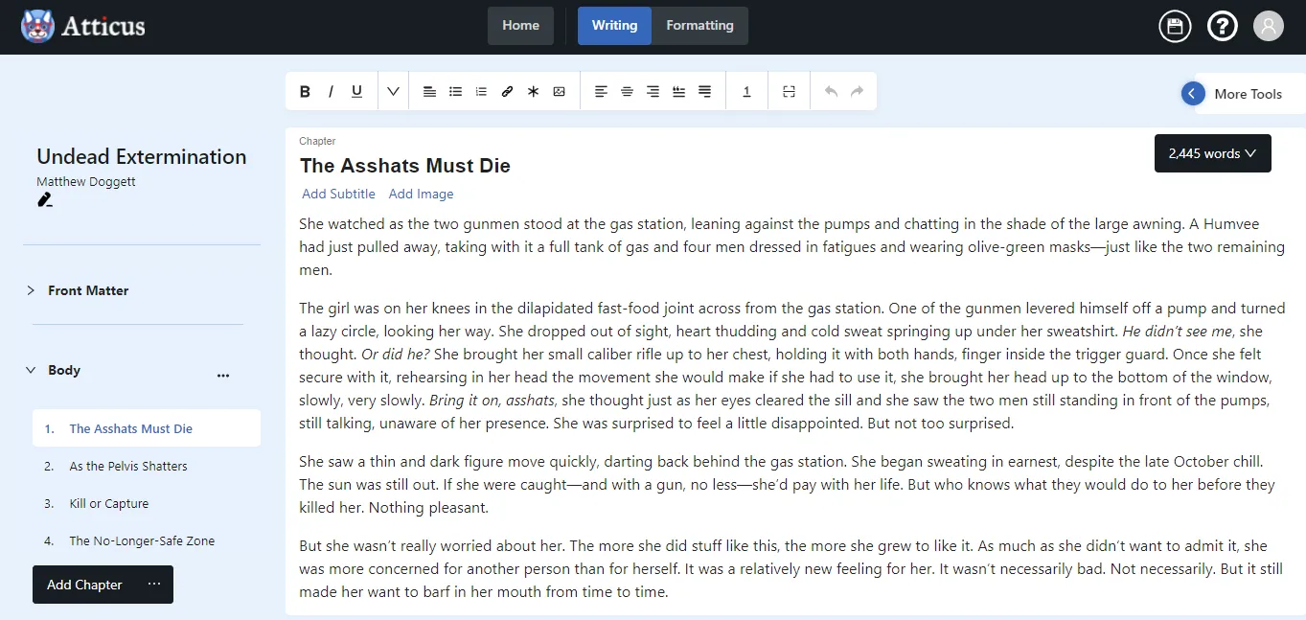
WebApp: Book writing software
Fig. 1: Atticus writing mode
Notes:
https://www.atticus.io/

Slide 2
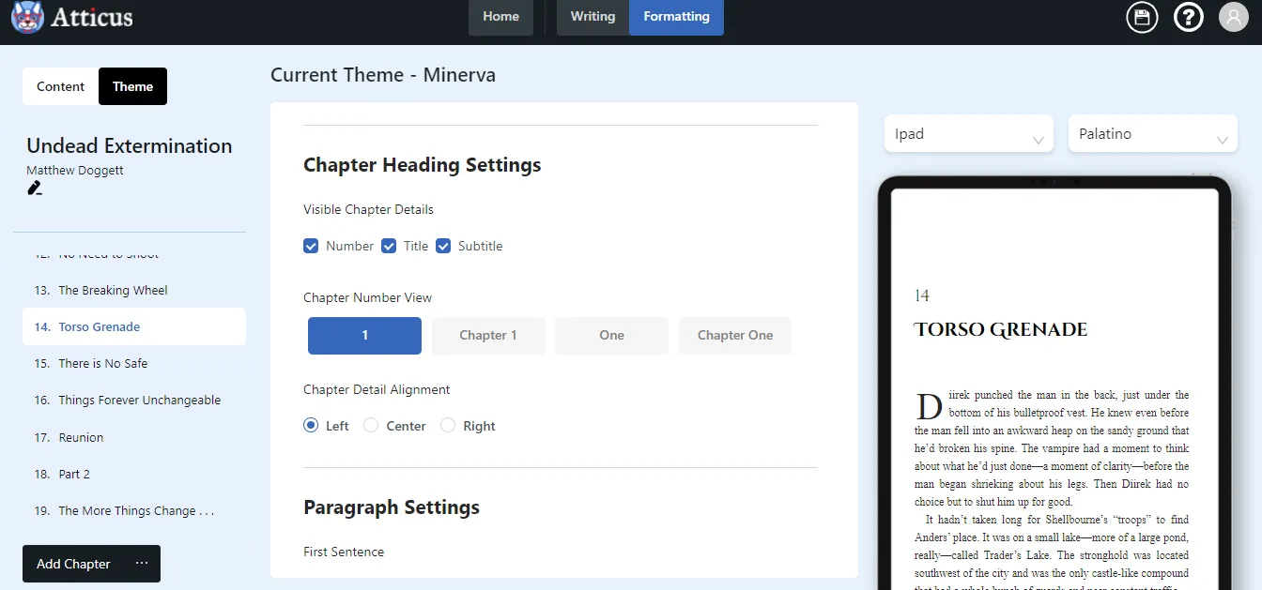
Fig. 2: Atticus formatting chapters individually in formatting mode

Slide 3
Features ¹
Color Code Meaning:
implement
Writing
Editing
Formatting
Themes
Front and Back Matter
Page Breaks
Chapter Options
Headers & Footers
Font Size and Spacing
Export Options
ePub — For use on Kindle and other eBook formats
PDF — For print books
docx — For editing and backups
Importing Options
DOCX, RTF, MOBI, and EPUB
ignore
unsure
Notes:
¹ Review of Atticus from https://medium.com/@mdoggett566/atticus-writing-software-review-1d9a167bc857

Slide 4
Word Count — For the entire book, the chapter, or the section
Device Previewer — 14 Different preview options to see how your book looks when formatted
Autosave Feature — It also supports backups and saves everything to the cloud
Use Online or Offline
Chapter Splitting
Spell Check
Full Bleed Images
Foot and Endnotes
Color Code Meaning:
implement
ignore
unsure

